Slide 1

Croeso! Welcome!
Coastal School
Leader Unit
L3

Slide 2
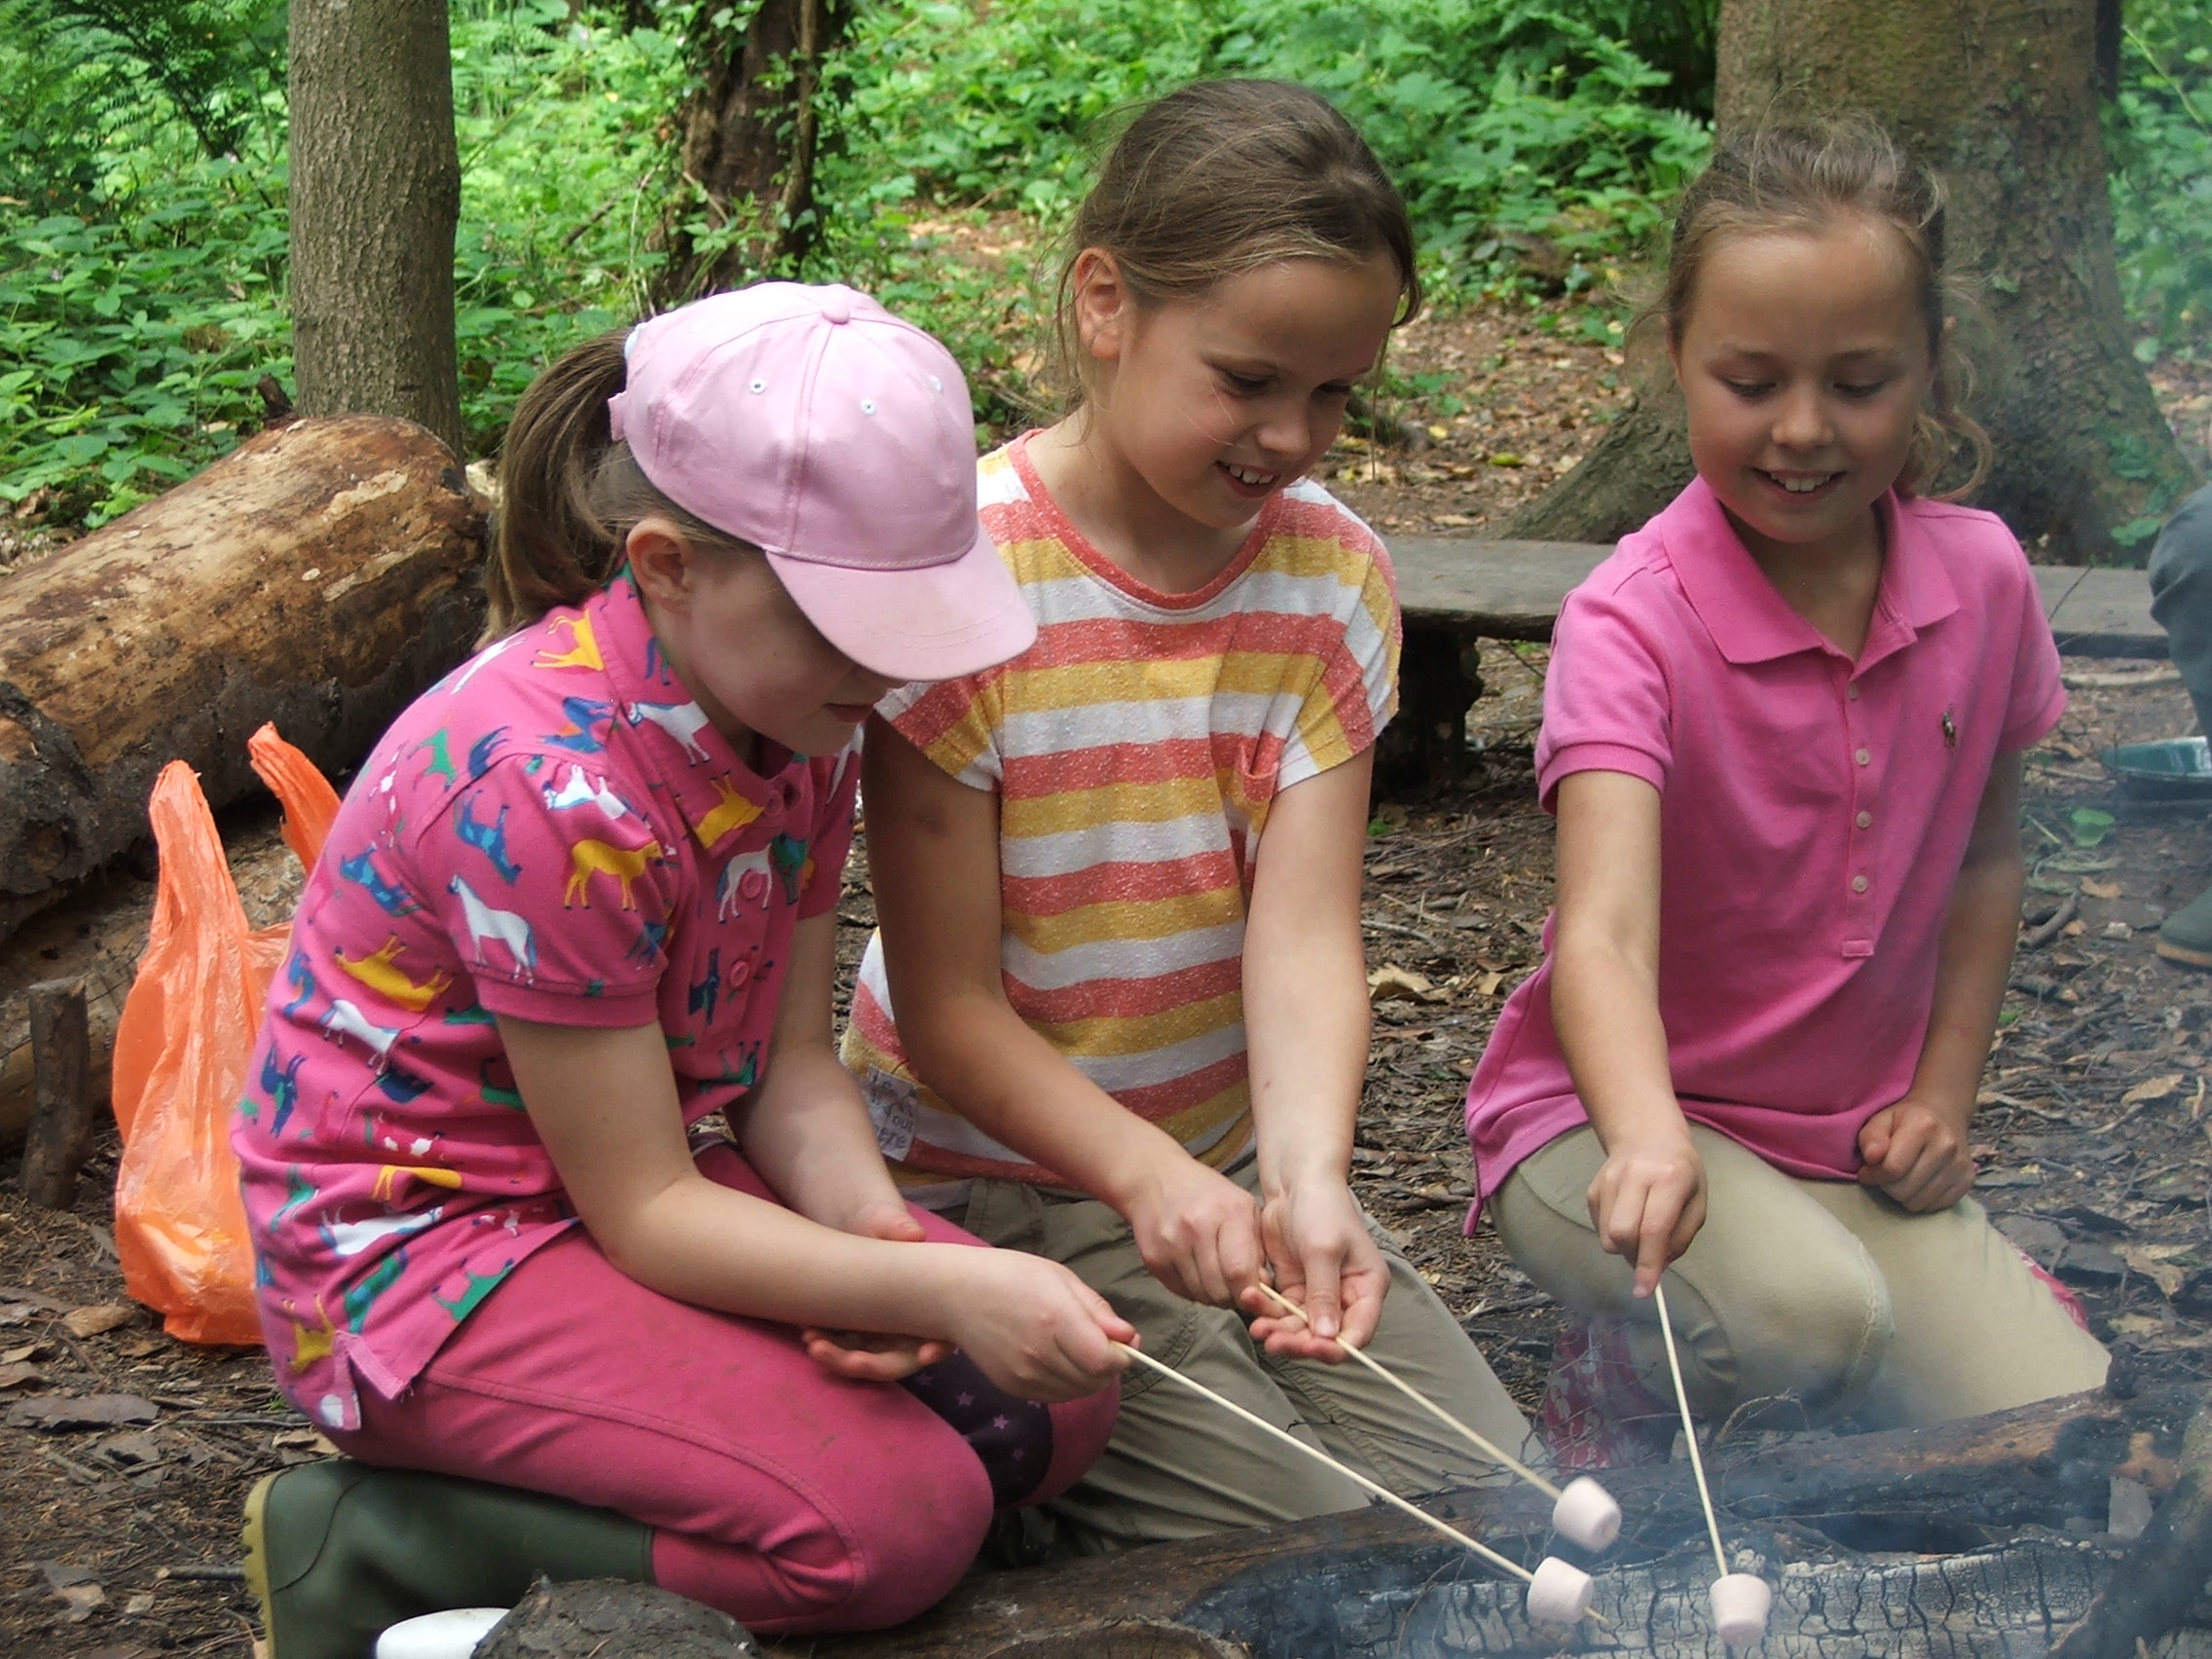
Forest School
Definition
Why Coastal School?
“An inspirational process that offers children, young people and adults regular opportunities to achieve and develop confidence and self-esteem through hands-on learning experiences in local woodland” O’Brian

Slide 3

Changing
Assess L&D
Stimulating
Calming
Trained Leader
Dev. Prac. Skills
Coastal Setting
Multisensory
What makes CS!
Resource rich
Dev. P&P
Accessible
Enable safe env.
Encourages ‘ownership’ of learning environment
Child Centred
Continuity
Allows relationship Building
Programme of Sessions
Individualised
Flexibility
Builds Confidence

Slide 4

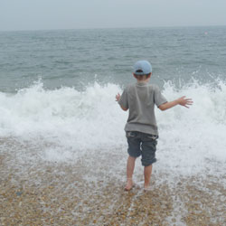
Benefits
Outcomes ?
Social and communication Skills
Inclusion
Practical skills
Raising learning attainment
Safety awareness of coastal habitats
Environmental
skills
and knowledge
Improved
Behaviour
Team building
Increased
Self-Confidence
Increased
Self-Esteem
http://www.forestandbeach.
co.uk/education.htm

Slide 5

Stimulating environment that gives enjoyable and peaceful experiences
High Adult:Child Ratio
Gives opportunities for challenge and risk
Finding out about things that interest them, not just things determined by others
How?
small achievable tasks
Time to PLAY outdoors, reflect, repeat and talk to peers and adults
A vehicle for positive social interaction and language building
Based on stage of learning rather than focussing on outcomes to be achieved
Engages people with their local outdoor
environment in a sustainable way
Enables physical activity

