Slide 1
PARENTS’
INFORMATION
EVENING
YEAR 6 SATS 2024

Slide 2
End of Key Stage Two Assessments 2024

Slide 3
Contents
 | What are end of key stage two assessments?
 | When do they happen?
 | What are the children tested on?
 | How are the tests administered?
 | What happens with the results?
 | How can I help my child?

Slide 4
What are end of key stage two assessments?
What you might know as SATs or Standard Attainment Tests, are national curriculum tests that are usually taken by children at the end of key stage two.
All children are assessed during the last term of Year 6; for 2024, this is in the week beginning 13th May.
The aim of the tests is to establish whether pupils are working at an expected level in English and maths for the end of primary school and the start of secondary school.
The results of the tests do not tell us how accomplished children are in other areas, such as sport, music or art.
Pupils sit six different tests in three subject areas: maths, English reading and English grammar, spelling and punctuation.
English writing judgements are made by the pupils’ teachers through teacher assessment, based on evidence of independent writing gathered over the course of Year 6.
Contents

Slide 5
When do they happen?
Every primary school will test their pupils on the same subject at the same time during the week beginning 13th May 2024. The schedule of tests for this year looks like this:
Assessment week 2024 | Tests
Monday 13 May | English grammar, punctuation and spelling Paper 1: questions Paper 2: spelling
Tuesday 14 May | English reading
Wednesday 15 May | Mathematics Paper 1: arithmetic Paper 2: reasoning
Thursday 16 May | Mathematics Paper 3: reasoning
Contents

Slide 6
What are the children tested on?
English
Grammar, Punctuation and Spelling
Paper 1: questions (45 minutes) 50 marks
A combined question and answer booklet which assesses pupils’ understanding of the grammar, punctuation and spelling elements of the national curriculum English programmes of study for key stage two.
Paper 2: spelling (15 minutes but not strictly timed) 20 marks
The paper that pupils receive has 20 sentences, each with a missing word. The teacher reads the sentences one at a time and pupils write in the missing word on their paper.
English
Reading
(1 hour) 50 marks
Pupils will have a reading booklet with three different texts to read and a corresponding question and answer booklet. The texts are presented in increasing levels of difficulty and pupils’ comprehension skills will be assessed against the comprehension elements of the English programme of study for key stage two.
Contents

Slide 7
What are the children tested on?
Mathematics
Paper 1: arithmetic (30 minutes) 40 marks
Pupils will have a booklet of arithmetic questions based on the national curriculum maths key stage two programmes of study.
Papers 2 and 3: reasoning (40 minutes each) 35 marks each
Both papers will ask children to reason and solve problems, again based on the national curriculum maths programmes of study.
Contents

Slide 8
How are the tests administered?
Most children will complete the tests in the Year 6 classroom.
Some children may complete their tests outside of the classroom in line with access arrangements specific to the needs of that child.
All tests are externally marked.
Writing will be ‘Teacher Assessed’ internally. However may have an external moderation but the children will be unaware of this.
School attendance is important – writing evidence to support teacher assessment continues after SATs which is important information for high school.
SEND: all children will sit the tests. However some access arrangements can be used We will let parents know individually of the access arrangements that we can apply.
These may be rest breaks, transcription of answers, reader. Children may be eligible for additional time.
Contents

Slide 9

What happens with the results?
For 2024, school results in the end of key stage assessments will be published in performance tables.
School results will be shared with the school, their local authority or academy trust and Ofsted to support school improvement.
Each child will receive a scaled score for their performance on the tests. This is a score between 80 and 120, where a score of 100 is considered to be average or working at the expected level of attainment at the end of primary school.
We will share pupils’ results in their end of year written report, which is sent home to parents in July.
Contents

Slide 10
What happens with the results?
A child awarded a scaled score of 100 is judged to have met the ‘national standard’ in the area judged by the test.
A child awarded a scaled score of more than 110 is judged to have exceeded the national standard and demonstrated a higher than expected knowledge of the curriculum for their age.
A child awarded a scaled score of less than 100 is judged to have not yet met the national standard
In reading, English GPS and Mathematics the following codes are used:
WTS Working towards the standard
NS At the national standard
HS Higher standard
For writing, the following codes are used:
HNM Has not met the standard
WTS Working towards the standard
EXS Working at the expected standard
GDS Working at greater depth
Contents

Slide 11
WRITING
Throughout the year the children will be composing independent pieces of writing to build up a portfolio of evidence.
This body of work will cover a range of genres that have been taught in class and provide evidence of the writing skills necessary to meet the expected standard.
In past years a best fit approach was used. However, now ALL of the skills must be grasped and applied in independent work to meet the expected standard.
Some children will be able to apply the skills consistently across most genres and will therefore be working at greater depth within the expected standard (GDS).

Slide 12
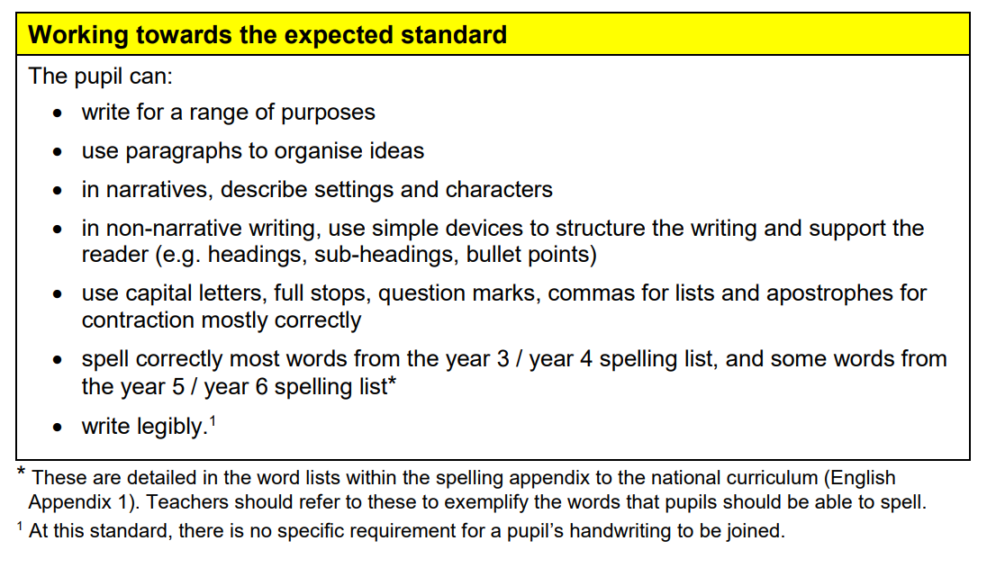
The Interim Framework
Writing….

Slide 13
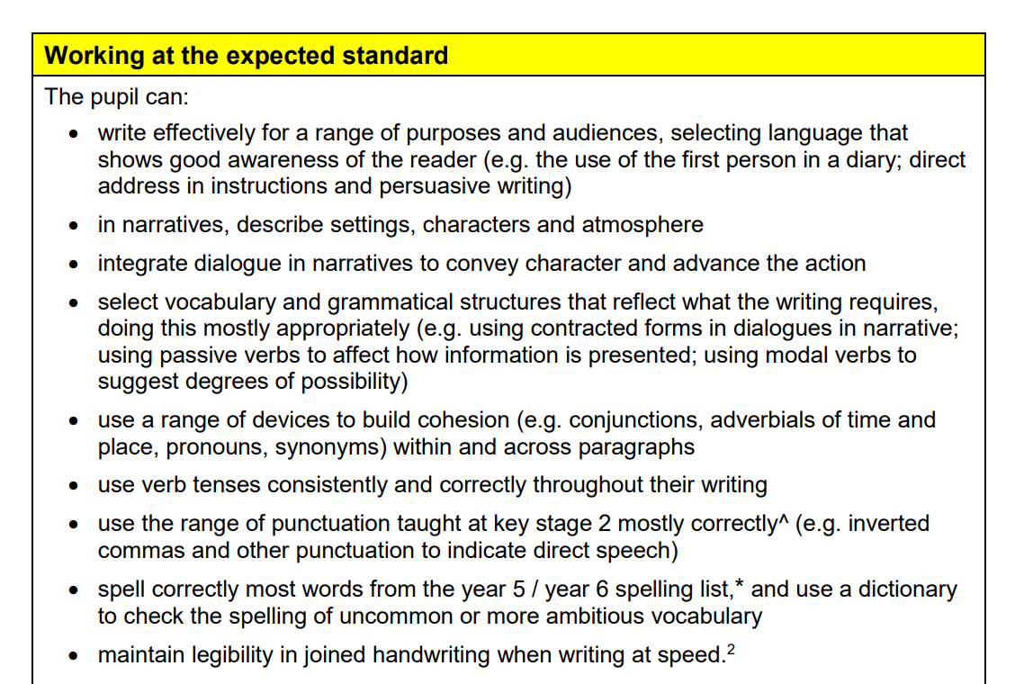
Expected standard for Writing

Slide 14
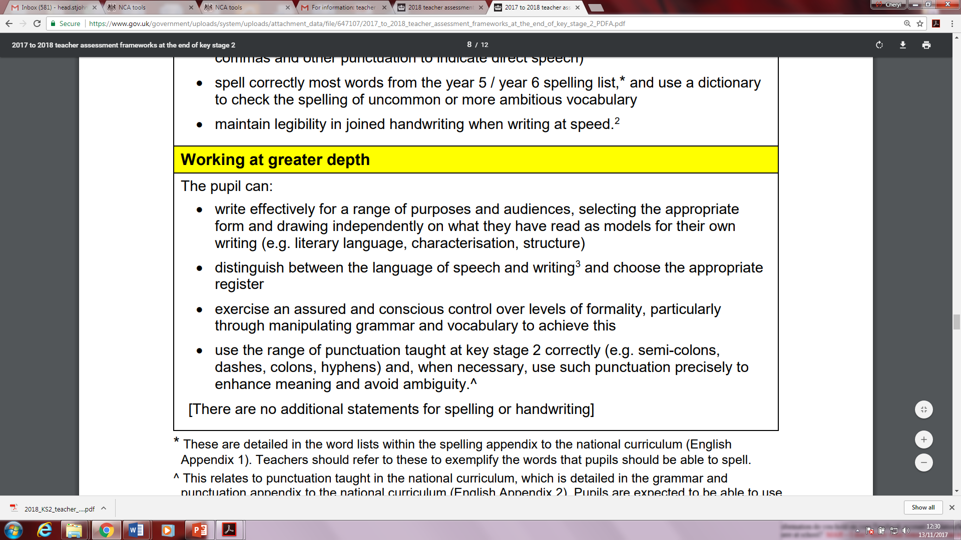
Working at Greater Depth for writing

Slide 15
Reading
The Reading Test consists of a single test paper with three unrelated reading texts.
Children are given 60 minutes in total, which includes reading the texts and answering the questions.
A total of 50 marks are available.
Questions are designed to assess the comprehension and understanding of a child’s reading.
Some questions are multiple choice or selected response, others require short answers and some require an extended response or explanation.
The Reading Test consists of a single test paper with three unrelated reading texts.
Children are given 60 minutes in total, which includes reading the texts and answering the questions.
A total of 50 marks are available.
Questions are designed to assess the comprehension and understanding of a child’s reading.
Some questions are multiple choice or selected response, others require short answers and some require an extended response or explanation.

Slide 16
The reading tests are challenging.
Children are
Exposed to challenging traditional and classic texts
Developing an extensive vocabulary
Building reading stamina
Teaching test techniques

Slide 17
Reading
“Characteristics” and “impressions of” are very important questions to ask children USING SYNONYMS.
… they crossed the glassy surface of the lake.
Give two impressions this gives you of the water.
Award 1 mark for reference to any of the following, up to a maximum of 2 marks:
reflective / shiny / mirror-like, e.g. the water reflects the light
shining under the sun.
clear / transparent, e.g. you could see through the water.
still / calm / undisturbed
flat / smooth.
Contents

Slide 18
Spelling, Punctuation and Grammar
A Spelling test is administered containing 20 words, lasting approximately 15 minutes.
A separate test is given on Punctuation, Vocabulary and Grammar
This test lasts for 45 minutes and requires short answer questions, including some multiple choice.
Marks for these two tests are added together to give a total for Spelling, Punctuation and Grammar.
A Spelling test is administered containing 20 words, lasting approximately 15 minutes.
A separate test is given on Punctuation, Vocabulary and Grammar
This test lasts for 45 minutes and requires short answer questions, including some multiple choice.
Marks for these two tests are added together to give a total for Spelling, Punctuation and Grammar.

Slide 19
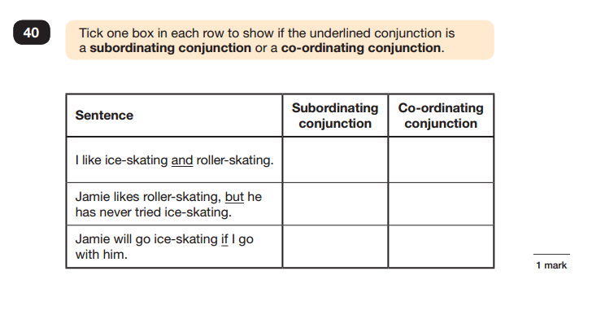
Sample Questions
Grammar, Punctuation and Spelling Paper 1

Slide 20
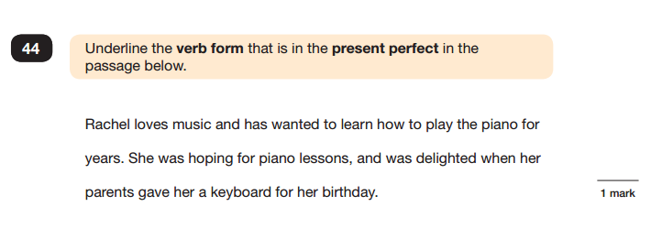
Sample Questions
Grammar, Punctuation and Spelling Paper 1

Slide 21
Mathematics
The Mathematics tests have undergone the biggest change this year.
Children will sit three tests: Paper 1, Paper 2 and Paper 3.
Paper 1 is for ‘Arithmetic’ lasting for 30 minutes, covering calculation methods for all operations, including use of fractions, percentages and decimals.
Questions gradually increase in difficulty. Not all children will be expected to access some of the more difficult questions later in the paper.
Papers 2 and 3 cover ‘Problem Solving and Reasoning’, each lasting for 40 minutes.
Pupils will still require calculation skills but will need to answer questions in context and decide what is required to find a solution.
The Mathematics tests have undergone the biggest change this year.
Children will sit three tests: Paper 1, Paper 2 and Paper 3.
Paper 1 is for ‘Arithmetic’ lasting for 30 minutes, covering calculation methods for all operations, including use of fractions, percentages and decimals.
Questions gradually increase in difficulty. Not all children will be expected to access some of the more difficult questions later in the paper.
Papers 2 and 3 cover ‘Problem Solving and Reasoning’, each lasting for 40 minutes.
Pupils will still require calculation skills but will need to answer questions in context and decide what is required to find a solution.
Children will sit three tests: Paper 1, Paper 2 and Paper 3.
Paper 1 is for ‘Arithmetic’ lasting for 30 minutes, covering calculation methods for all operations, including use of fractions, percentages and decimals.
Questions gradually increase in difficulty. Not all children will be expected to access some of the more difficult questions later in the paper.
Papers 2 and 3 cover ‘Problem Solving and Reasoning’, each lasting for 40 minutes.
Pupils will still require calculation skills but will need to answer questions in context and decide what is required to find a solution.

Slide 22
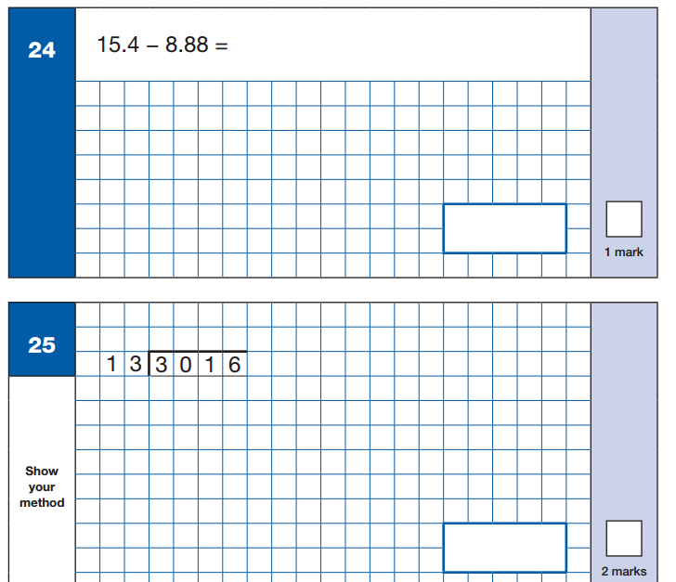
Sample Questions
Maths Paper 1: Arithmetic

Slide 23
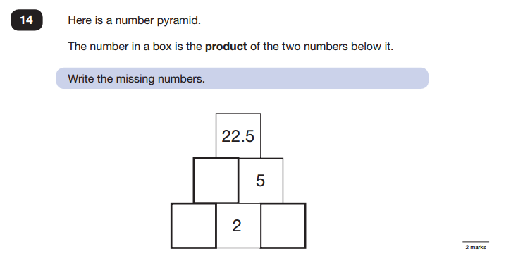
Sample Questions
Maths Paper 2 / Paper 3 : Reasoning

Slide 24
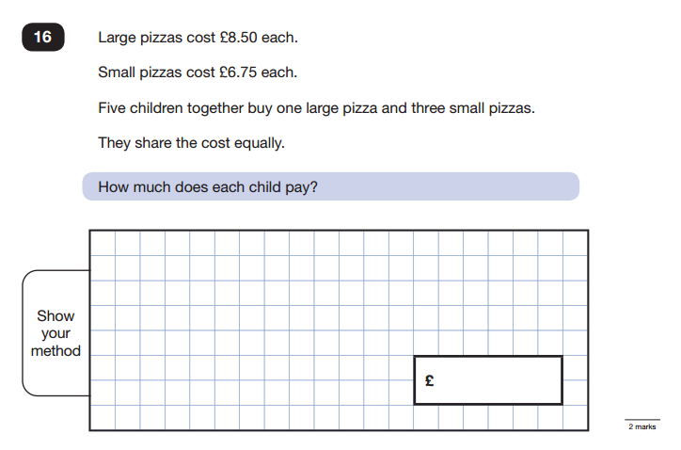
Sample Questions
Maths Paper 2 / Paper 3 : Reasoning

Slide 25
How can I help my child?
Support your child to complete any home learning tasks sent home, such as spelling activities, reading comprehensions and maths sheets
Use online activities like Times Tables Rock Stars, BBC Revise Wise to practise skills at home.
Encourage them to manage their time.
Encourage them to try their best, commend their efforts and plan to celebrate their hard work at the end of the testing week, rather than focusing on the test results.
Contents

Slide 26

How can I help my child?

Slide 27
How can I help my child?
Ensure your child has the best possible attendance AND punctuality– EVERY SINGLE LESSON COUNTS
Lessons are planned as a sequence so even missing one will impact on the children’s progress and interrupt their learning.
In addition, important revision sessions and booster classes take place each day to make the children feel more confident and prepared.
There should be no absences in the lead up to the SATs or during the SATs week.
The children will continue to develop their writing skills and evidence until the end of June. The writing is teacher assessed……..
Good attendance is vital.

Slide 28

SATS WEEK …
Free breakfast club
for all Year 6 children!
8:30 am

