Slide 1

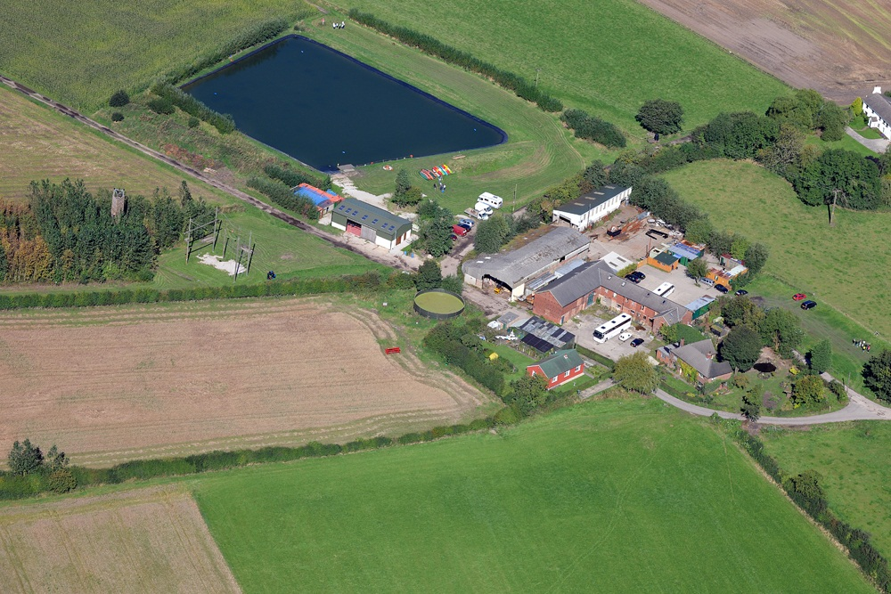
Rock & River 2024

Slide 2
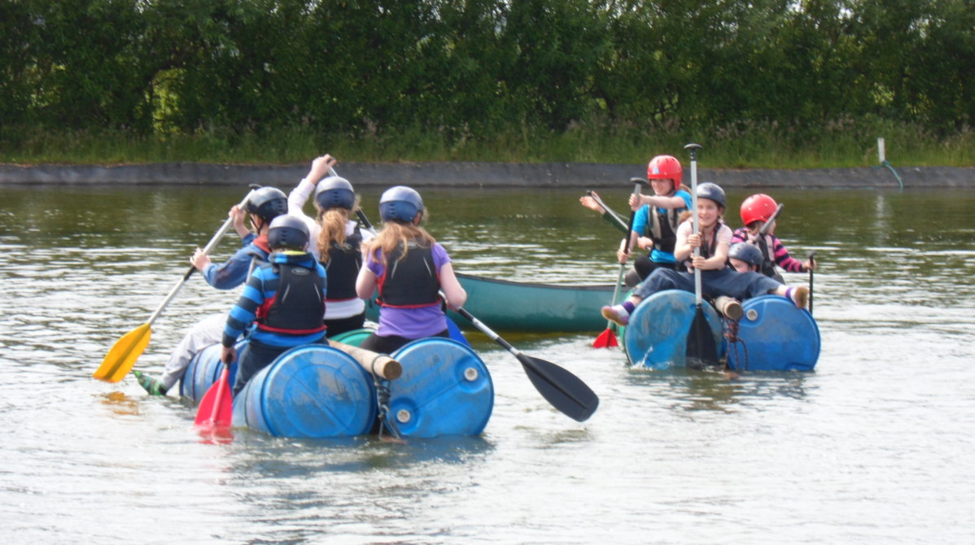
Year 6 Multi Activity Days
To know the format of the outdoor multi-activity visits
Dates and schedules
To look at the activities
To look at the itinerary
Kit list
Arrival and return arrangements

Slide 3
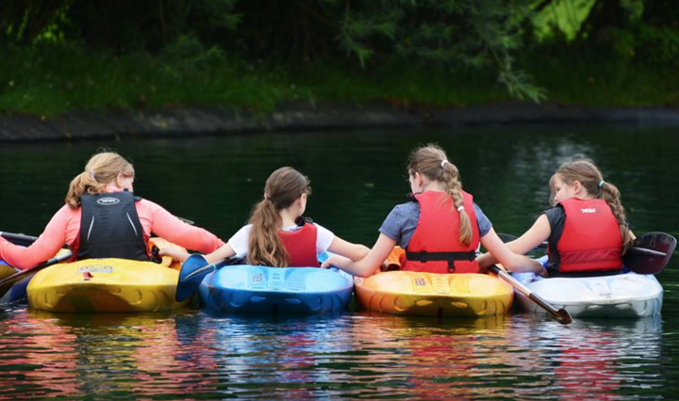
Rock and River – Why and When?
Two full day multi-activity events:
Summer term … post-SATS
High quality provision
Action packed …. 11 adventurous, including water activities
Summer Term Dates:
Day 1 – Tuesday 9 July 2024 8:30 – 5:30 and
Day 2 – Wednesday 10 July 2024 8:30 – 5:30 (pick up 6:30 after supper)
COST: £70 per child for Rock & River plus transport = £100. However, the school funds both days using the Sports Premium and PTFA donations.
Chippy supper: £3 - £5 approx. ( optional to have chippy supper but is a charge)

Slide 4

PURPOSE
To increase confidence and self-esteem
To develop a range of activity related skills
To enjoy outdoor participation in outdoor activities, adopt positive attitudes and develop resilience
To have a action packed, brilliant time with our friends!

Slide 5
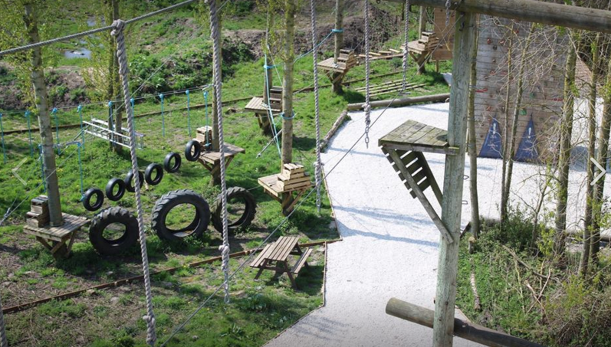
Rock and River
Rock and River are Outdoor Pursuits specialists
They have been running adventurous outdoor activities since 1996
All instructors are fully qualified and experienced
They all undergo in-house training assessments in all the activities they lead
Learning Outside the Classroom (LOTC) Quality Badge

Slide 6
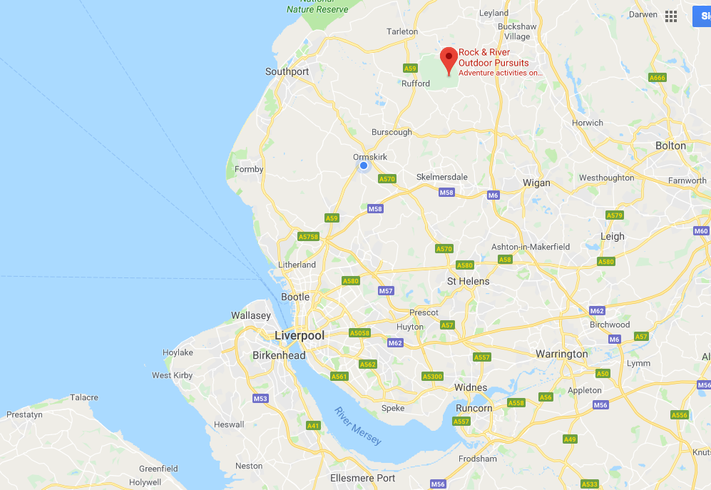
Rock and River – Where is it?
Cliffs farm Activity Centre
Wood Lane
Mawdesley
Nr Ormskirk
Lancashire
L40 2RL

Slide 7
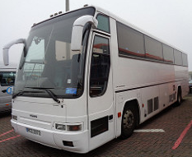

Coach Firm
Let’s Travel, Hawthorne Road, Bootle, L20 9RP

Slide 8
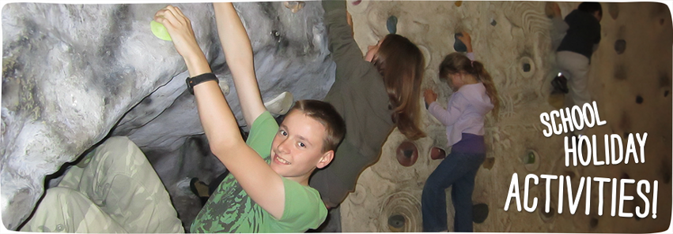
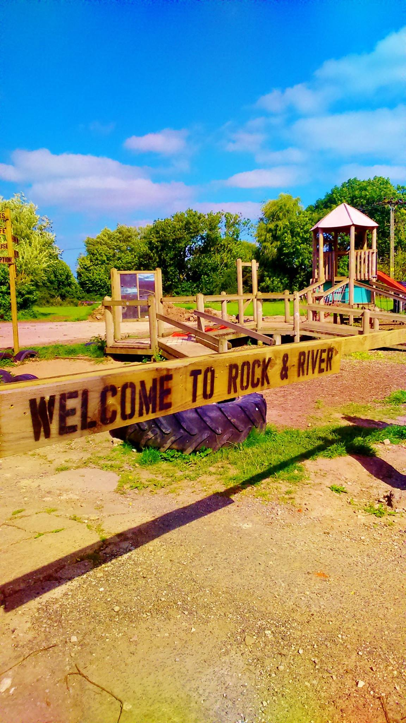
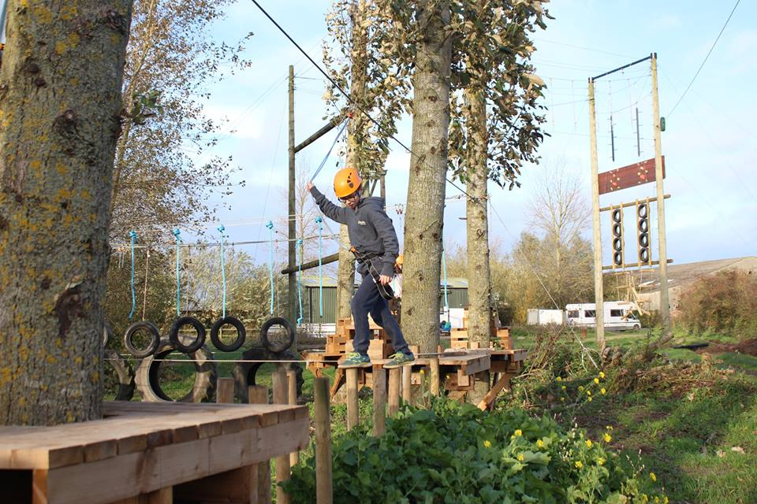
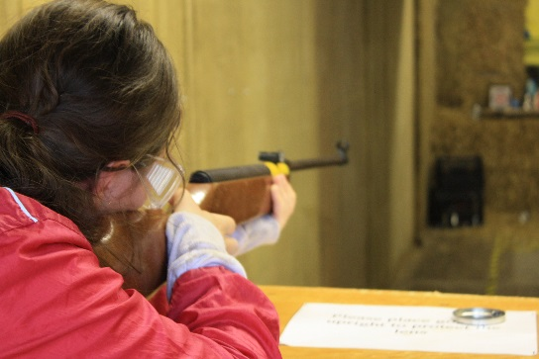
Activities

Slide 9
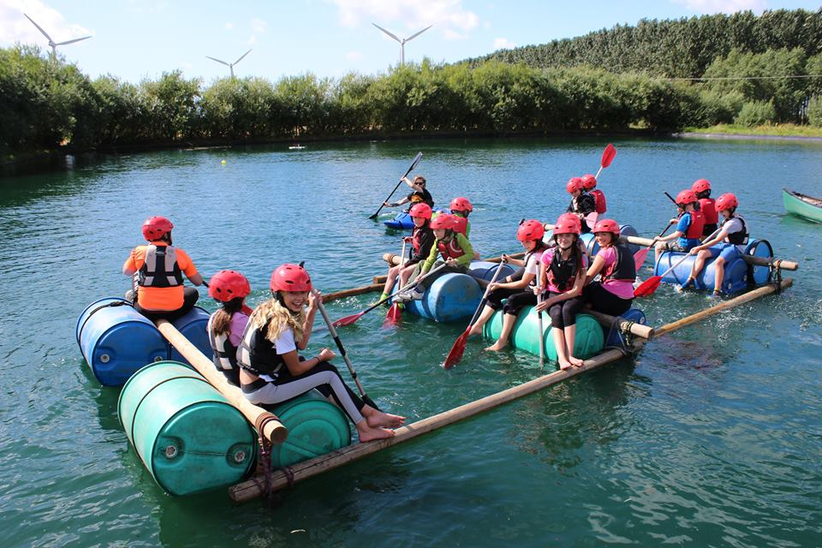
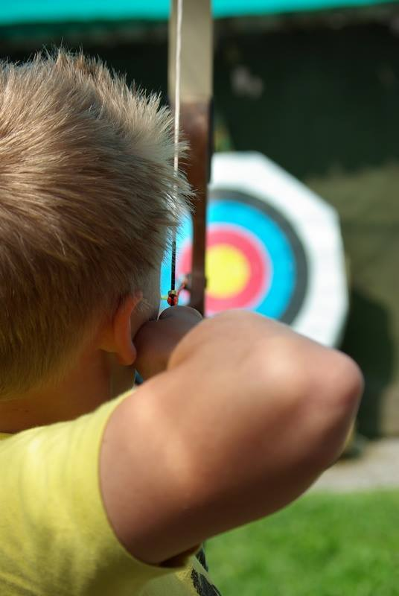
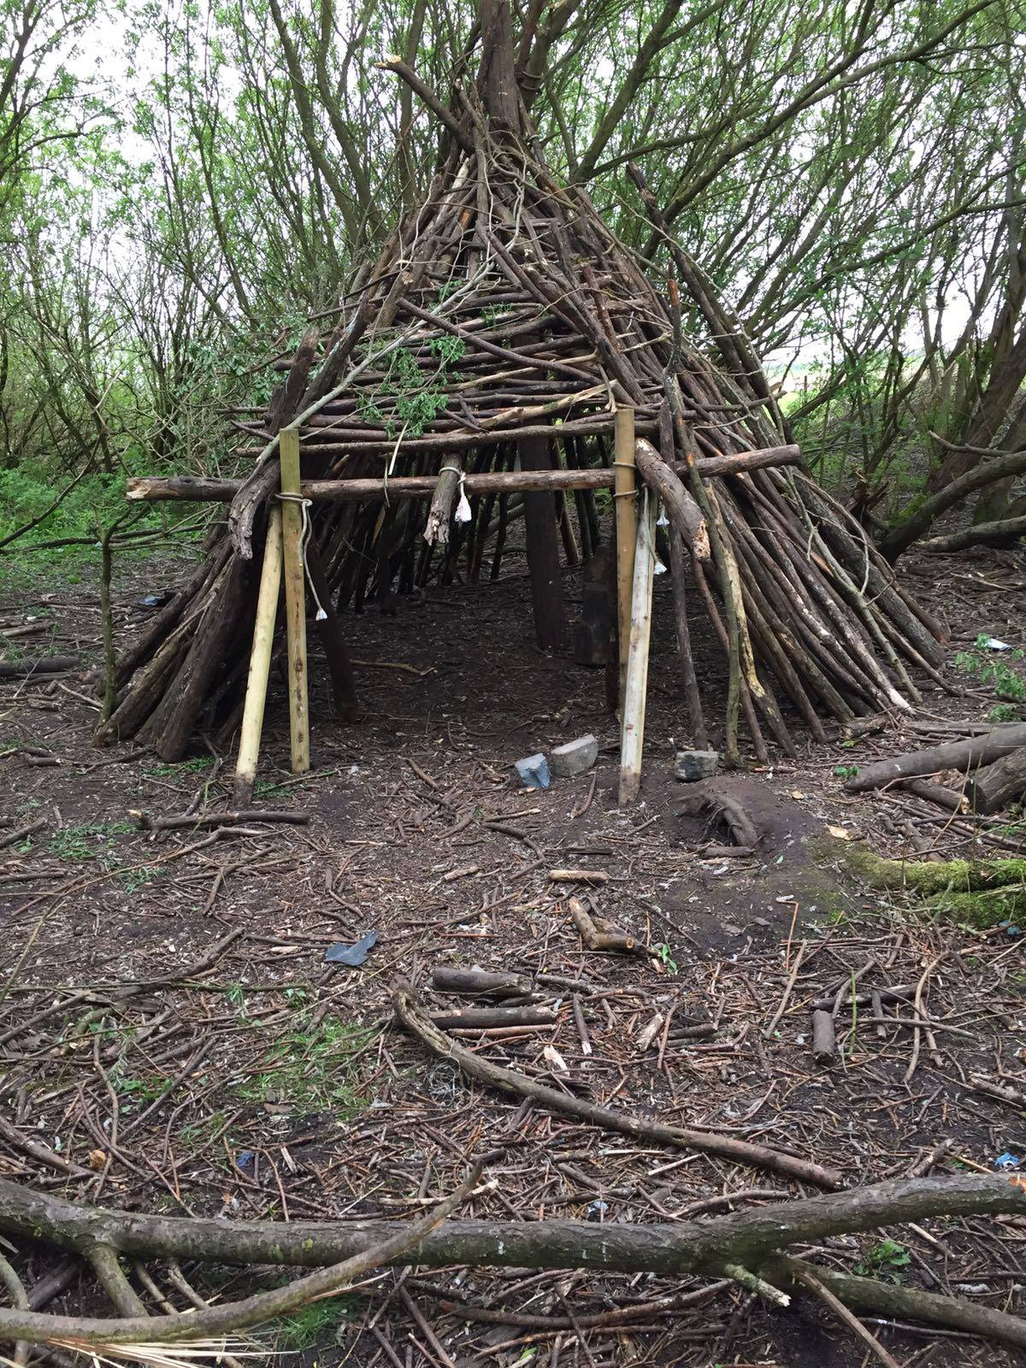
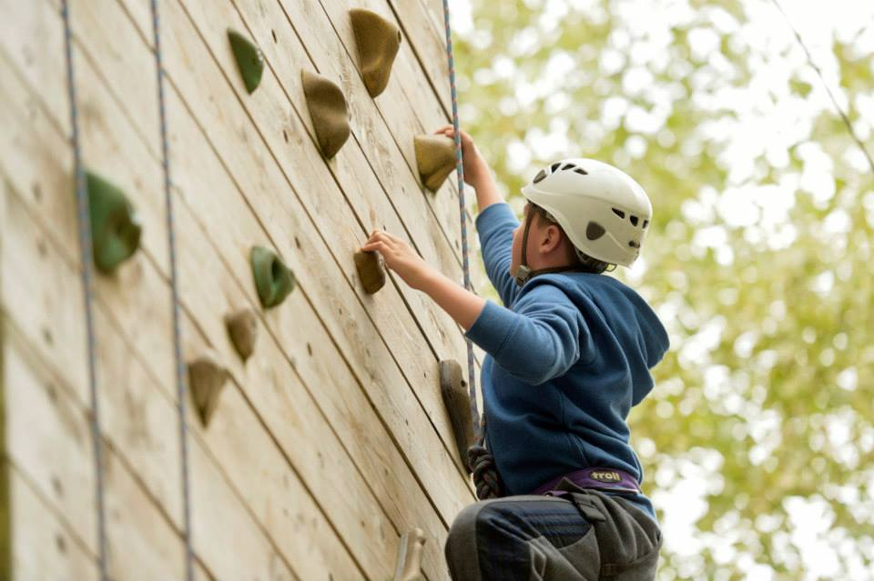
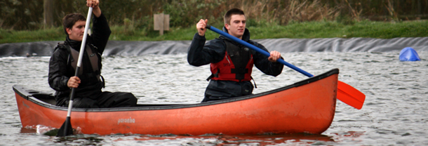

Activities

Slide 10
Schedule – Day 1
TIME | Activities
8:15 am | Arrive early - In Year 6 classroom for 8:15am
8:30 am | Departure
9:30 am | Arrival
10:00-12:30 | Archery & Shelter Building/Fire Lighting
12:30-1.20 pm | Lunch Break
1.30 – 4.00 pm | Climbing Tower Low Ropes Course Zip Line
4.00 – 4.30 pm | End of activities & departure
5.30 pm | Arrive back at St. John’s School Children must be collected by an adult.

Slide 11
Schedule – Day 2
TIME | Activities
8:15 am | Arrive early - In Year 6 classroom for 8:15am
8:30 am | Departure
9:30 am | Arrival
10:00-12:30 | Orienteering & Air Bag Jump
12:30-1.20 pm | Lunch Break
1.30 – 4.00 pm | Rafter Canoes Sit-on Kayaks Paddle Boards Mega Paddle Boards
4.00 – 4.30 pm | End of activities & departure
5.30 pm | Arrive back at St. John’s School (collected from school by an adult if not staying for supper) Chippy tea at school
6. 15 pm | Collected from school by an adult (if staying for supper)

Slide 12
KIT LIST
What to bring with you:
Complete change of clothes (including shoes)
Medication (if required)
Packed lunch
Waterproof jacket
Waterproof trousers (if you have them)
Fleece Jacket
Towel
Sun cream and hat / winter hat and gloves
Bin Bag (for wet clothes)

Slide 13
KIT LIST
What to Wear:
Tracksuit bottoms/leggings/shorts
Thin layers (e.g. T-shirts etc)
Fleece or Jumper
Walking boots or trainers
Please do not wear:
Welly Boots for water activities
Jeans or Denim
Woollen jumpers
ANY Jewellery (e.g. ear rings, rings etc)

Slide 14

How can you help?
Names in clothes!
Check the kit list with your child
Make sure your child pack their own rucksack.
Plastic bags to put wet clothes in – not black. Make sure it is labelled!!!!
Travel sickness tablets and all medication labelled and handed to Miss Fitspatrick.
Discuss the code of acceptable behaviour with known consequences if not adhered to.
No mobile phones.

